Slide 1






Round 1 Idea Submission
Syntax Squad
Harsh Jangid(L), Harsh Depura,Ishan Gupta ,
Harsh Goyal Bairwa
Open Innovation
Music

Slide 2
[Syntax Squad]
IDEA TITLE
An AI-powered, immersive, and interactive virtual piano platform that leverages machine learning, augmented reality, and gamification to revolutionize music education and entertainment.
AI-driven personalized learning paths and real-time feedback
AR integration for an immersive piano-playing experience
Gamification elements to increase engagement and motivation
Social features for collaboration, sharing, and community building
Integration with popular music streaming services for access to a vast music library
Increases accessibility and affordability of music education
Provides an engaging and interactive learning experience
Fosters creativity, self-expression, and community building
Supports the music industry through increased engagement and sales
Innovation and uniqueness:
AI-powered personalized learning
AR integration for immersive experience
Gamification elements for increased engagement
Social features for community building and collaboration

Slide 3
[Syntax Sqaud]
TECHNICAL APPROACH
Technologies used :
Frontend: HTML5 ,CSS , JavaScript: and React
Audio and MIDI: MIDI protocol
Music Theory Module:JavaScript

Slide 4
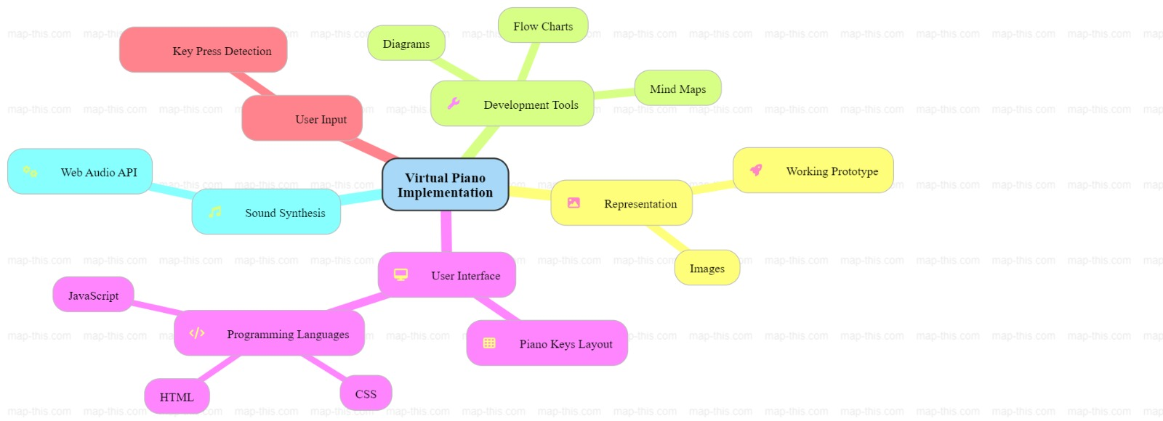
Syntax Squad
METHODOLOGY

Slide 5
Syntax Squad
FEASIBILITY AND VIABILITY
Technical feasibility: High (leveraging existing AI, AR, and gamification technologies)
Financial feasibility: Medium (requires significant investment in development and marketing)
Market feasibility: High (growing demand for online music education and entertainment)
Potential Challenges and Risks:
Technical challenges in integrating AI, AR, and gamification elements
Competition from existing music education platforms
User adoption and retention rates
Ensuring high-quality user experience and feedback
Addressing copyright and licensing issues for music library integration
Strategies for Overcoming Challenges:
Partner with experts in AI, AR, and gamification for development
Conduct market research and user testing to inform platform development
Offer free trials and demos to increase user adoption
Implement user feedback mechanisms and continuous improvement
Establish partnerships with music industry stakeholders for licensing and copyright agreements

Slide 6
[Syntax Squad]
IMPACT AND BENEFITS
Accessibility: Virtual piano on Musicca allows users to play using a keyboard or mouse, making it accessible to those without a physical piano​
Educational Value: Provides free exercises to learn notes, chords, scales, and intervals, enhancing both practical and theoretical music knowledge​
Useful for Schools: Ideal for students and teachers, enabling interactive learning and practice both in class and at home​
Music Theory Integration: Works with other tools like chord and interval finders to deepen understanding​
Global Impact: Promotes accessible music education to a broad audience worldwide​
BENEFITS:
Web-based virtual piano application
Interactive piano keyboard using HTML5, CSS3, and JavaScript
Real-time sound generation using MIDI protocol
Music theory module for interactive lessons and exercises
How it addresses the problem:
Provides access to piano learning and practice from anywhere
Fills the gap in music education resources
Offers a structured learning experience
Innovation and uniqueness:
Integration of MIDI protocol and music theory module
Web-based platform for easy accessibility and scalability
Interactive and immersive virtual piano experience

Slide 7
[Syntax Squad]
CONCLUSION
"Harmonizing Innovation and Education: Our Virtual Piano Project Strikes a Chord!"

Slide 8
[Team Name]
IMPORTANT RULES AND INSTRUCTIONS
Try to avoid paragraphs and post your idea in points /diagrams / Infographics /pictures.
Keep your explanation precise and easy to understand.
Idea should be unique and novel.
You can only use provided template for making the PPT without changing the header of each slide and the very first slide.
You need upload the slides to Unstop Submission Portal within the mentioned time.
Submission beyond the specified time will not be entertained. Do not mail the authorities your submission once time is exceeded.
Note - You can delete this slide (Important Pointers) when you upload the details of your idea on Unstop portal.

